Slide 1
Presentation for SUMMER UNDERGRADUATE RESEARCH AWARD (SURA) – 2018 Design of an Integrated Semi-Autonomous Regular Health Monitoring Machine
Kshitij Gupta Tanmay Goyal
Dept. of Mechanical Eng. Dept. of Mechanical Eng.
2016ME20760 2016ME20757
Contact No: 07827151976 Contact No: 09821898027
CGPA: 9.18 CGPA: 8.64
FACILITATOR
Prof. Devendra Kumar Dubey Assistant Professor Department of Mechanical Engineering Indian Institute of Technology Delhi
Prof. S.K. Saha
Head of Department
Department of Mechanical Engineering IIT Delhi

Slide 2
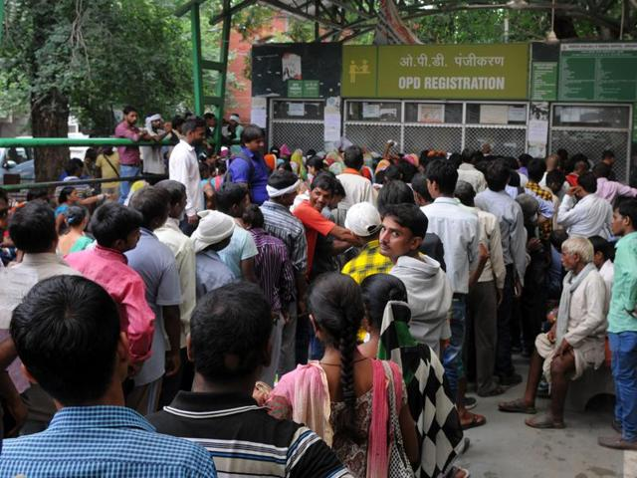
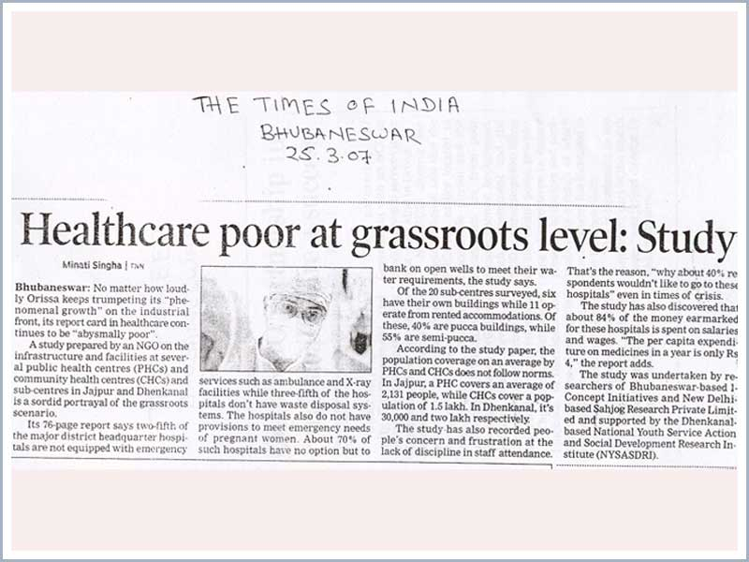
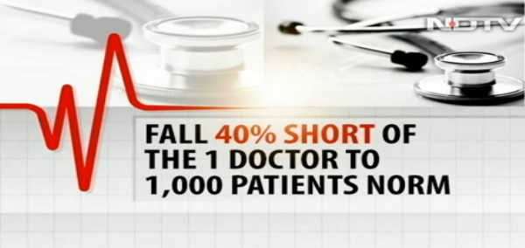
Motivation
Poor delivery of healthcare, non-availability of simple and standard technologies to the rural population.
Lack of instruments that are easily accessible to the urban populace like the BP machine, thermometer or body weighing machine.
Cumbersome task of separate testing of each parameter
Storage of health records for comparing results with future tests

Slide 3
Objective
To design an Integrated Semi-Autonomous Regular Health Monitoring Machine incorporating various medical devices, study their working and develop them using numerous electrical sensors.
To integrate/ make machines monitoring -
Blood Sugar level
Blood pressure
Body Weight and height
Body Temperature
Lung power and capacity
To enhance the convenience of regular health monitoring by-
Making the system Semi-Autonomous.
Make device user friendly to be operated easily by a layman
Developing a final health report (electronic and physical) based on a basic medical assessment. We would store data electronically in order to compare in the future.
Providing a brief analysis of the report as well as some basic health tips to the user.

Slide 4
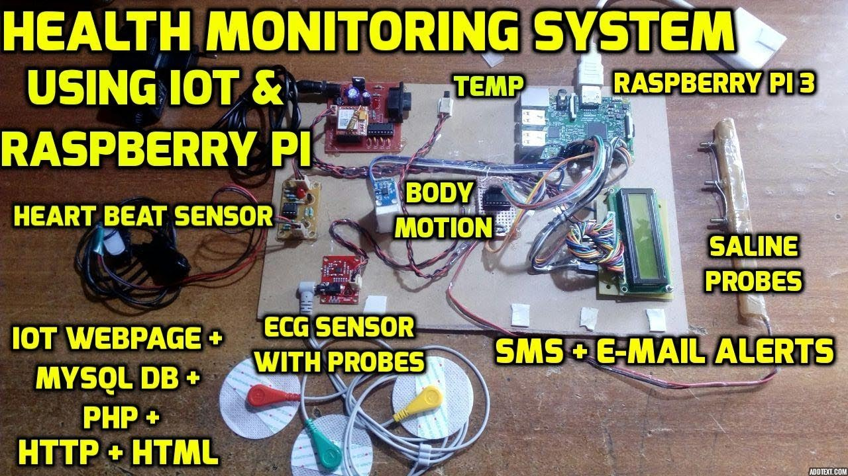
Literature review
Integrated machine health monitoring is relatively a newer concept.
None of the devices we found targeted the very specific end that we’re trying to achieve.
Health monitoring Systems | Continuous monitoring of a patient during operations. May use IOT to establish communication among the devices. Remote monitoring; data transfer
ReMeDi Organisation | Requires semi-skilled operators for basic testings. Video and audio connect between patients located in rural areas and remotely located physicians, enabling real-time consultations.
Ours | Testing of health basic parameters. No requirement of additional technical assistance. Electronic storage & analysis of results.

Slide 5
Novelty
Integrated system : combined and fast results
Technical know-how : minimal
Automation : user friendly
Electronic storage of data : reference for future tests
Health tips : Basic health tips will be provided
Time/effort saving : data can be electronically transferred to the doctor
Future scope : can be made more cost effective, requiring lesser maintenance and more accurate; may find many applications

Slide 6
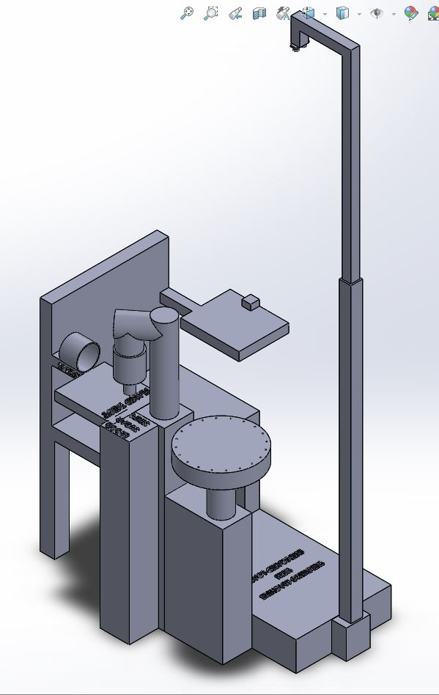
Approach

Slide 7
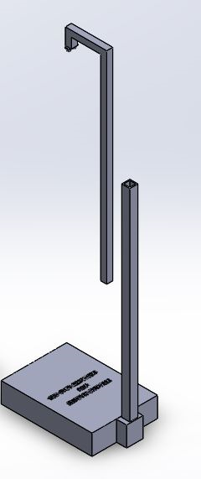
Body weight and height
We would use platform scales load cells for measuring the body weight.
The device (~100 kg scale) would be placed in front of the chair and an extensible rod with ultrasonic sensor at the top would be attached to it.
The rod would rise up using linear actuators. The ultrasonic sensor would thus give the height of the person standing below it.
Notes:
Why used ultrasound
Why used load cell
Why used pistons
We have to see working of ultrasound
Load cell working

Slide 8
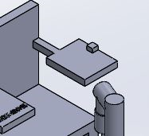
Body temperature
We’ll use LM-35 sensors to measure the body temperature. Provisionally, we plan to measure temperature from the fingertip.
We’ll try to find a more accurate and convenient alternative for measurement.
Notes:
Lm 35 is a temperature sensor
It is an ic that gives analog output by voltage variation proportional to temperature
It has 3 pins – ground, Vs, Vout

Slide 9
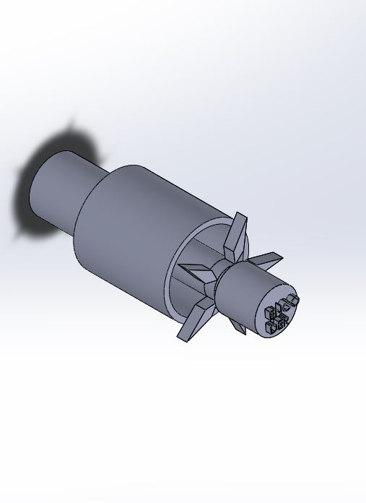
Lung power and capacity
We will use a device based on working of anemometer to find the speed and pressure of the air blown out
An encoder will be attached to a rotating fan will measure the number of rotations and speed of rotation (for a single blow) the value of which would be calibrated suitably to measure the lung power and capacity.
We can also use it as a respiratory exerciser, which is commonly used by asthmatic patients.

Slide 10
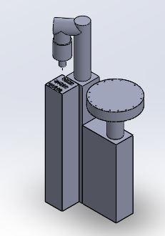
Blood sugar level
We plan to incorporate a system for blood sugar level measurement in our design. An extended chair base fitted with a stepper motor which would produce rotary motion of a suction unit.
This suction unit comprises a linear actuator with disposable syringe, which would collect blood sample from the fingers. Another linear actuator would be used for suction.
This blood sample would be fed into blood glucose meter strip after a fixed angle rotation of the suction unit. These strips would be changed using a gripper that feeds the strips into the machine and then removes. The suction unit would move further a fixed angle to dispose the syringe.
After another fixed angle rotation, new syringe would be put in place (the syringes are fitted in a 2D round acrylic sheet acting as rotating table which rotates a fixed angle every time a new syringe is extracted).

Slide 11

Blood pressure
We plan to use an automatic fitting strap (using motor and pressure sensor) together with a wrist blood pressure monitoring machine.
We are using a strain gauge/ load cell to measure the resistance in motor motion to stop motor once band is tightened.

Slide 12
Plan of action
TASKS | WEEK 1 | WEEK 2 | WEEK 3 | WEEK 4 | WEEK 5 | WEEK 6 | WEEK 7 | WEEK 8
Study of devices/sensors
Mechanical design study
Body weight and Height
Body Temperature
Blood Pressure
Blood Sugar level
Lung Capacity
Integration
Testing

Slide 13
Budget
Blood Glucose Level |  | 2000
Pressure transducer/ BP machine |  | 2000
Low torque motors | 2 | 2000
Arduino + HC 05 |  | 1000
Load cells |  | 1000
Pistons (1 short stroke + 2 long stroke) | 3 | 2300
Ultrasound sensor |  | 300
Encoder |  | 1500
LCD |  | 1000
Motor controllers |  | 2000
Tubes + wires + X channel |  | 1500
Extra materials |  | 2000
Stepper motors | 2 | 3500
Syringes + LM-35 sensors |  | 300
Pressure sensor/Strain gauge/load cell |  | 500
Anemometer + Miscellaneous |  | 2000
Total |  | 24,900

Slide 14
References
1) https://ihealthlabs.com/measuring-blood-pressure-daily-important-hypertension/
2) Dr. Morepen Gluco One Blood Sugar Meter BG-03 and test strip 25,50,75,100 combo | eBay
3) https://www.ijser.org/researchpaper/Vein-Detection-System-using-Infrared-Light.pdf
4)http://www.diabetes.org/living-with-diabetes/treatment-and-care/blood-glucose-control/checking-your-blood-glucose.html?referrer=https://www.google.co.in/
5) https://www.brunet.ca/en/advices/the-importance-of-monitoring-blood-glucose-levels.html
6) http://healthmarketinnovations.org/sites/default/files/ACCESS_NSCPL_Case_study_Final%20%281%29.pdf
7) http://community.parkview.com/blog/parkview-health-2/how-to-measure-and-hit-a-healthy-blood-pressure
8)https://www.flipkart.com/dr-trust-precision-body-composition-monitor-fat-analyzer-weighing-scale/p/itmffc4nmkv5dugu?pid=WSLFFC2ZZF7DK8RP&start_url=BrowserLaunch_AMP
9) https://www.amazon.in/dp/B06X3Y6S4V?ref_=Oct_CANReleaseC_3150030031_3
10) https://www.youtube.com/watch?v=5LWM_5k8R1E
11)https://www.forbes.com/sites/suparnadutt/2016/11/21/indias-most-remote-villages-are-getting-better-healthcare-with-this-cloud-based-solution/#d64c9bf593b1
12) https://link.springer.com/article/10.1007/s13198-013-0178-1
13) https://ieeexplore.ieee.org/document/5404166/
14) http://www.stylecraze.com/articles/how-to-test-your-lung-capacity-at-home/#gref
15) https://www.flipkart.com/omron-hem-7320-t-bluetooth-smart-japanese-bp-monitor/
16) https://store.fut-electronics.com/products/blood-pressure-sensor-module
17) http://www.mediplusindia.com/products/respiratory-exerciser/
18) https://wiki.eprolabs.com/index.php?title=Temperature_Sensor_LM35
19) https://www.robotshop.com/en/actuators.html
20) https://dir.indiamart.com/impcat/ultrasonic-anemometers.html
21) https://en.wikipedia.org/wiki/Ultrasonic_transducer
22)https://googleweblight.com/i?u=https://www.cooking-hacks.com/documentation/tutorials/raspberry-pi-to-arduino-shields-connection-bridge/&hl=en-IN&tg=422&tk=8930665449229169659

Slide 15
Thank You

